Slide 1

1
Page 01
GROUP
UFA
SIGHTINGS
-

Slide 2

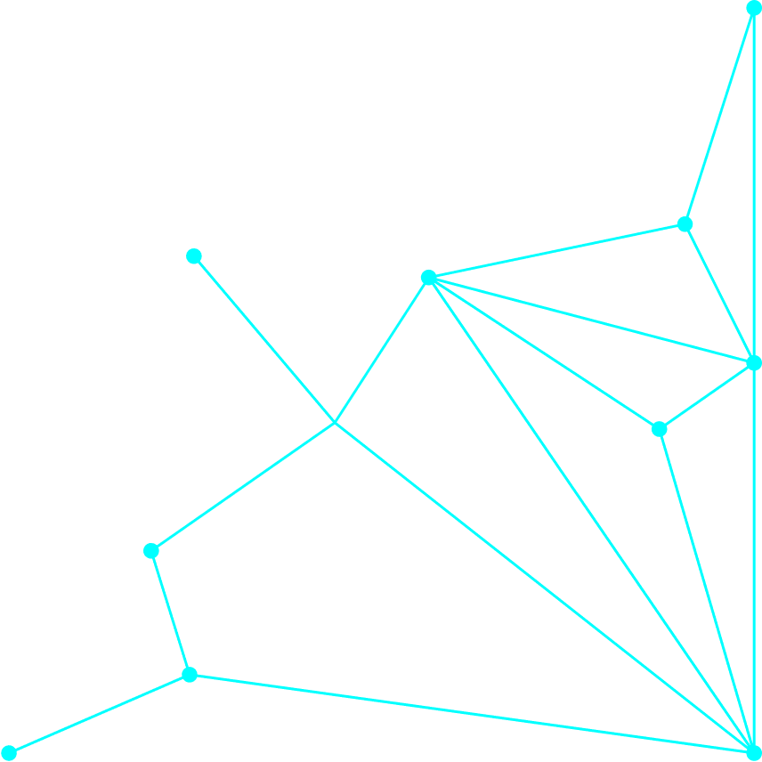
1
Page 02
GROUP
INTRODUCTION
Malumot manbai: Keggel.
Maqsad: Malumotlarni asosiy naqshlar, munosabatlar va tendensiyalarni aniqlash uchun.
Foydalanilgan vositalar: Python (Pandas, Matplotlib)

Slide 3
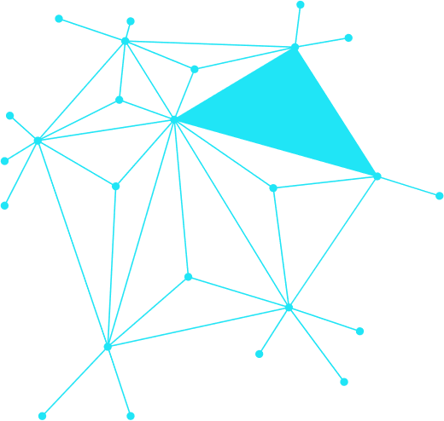

1
Page 03
GROUP.
MA’LUMOT TAVSIFI(ABOUT TO DATASET)
Mazkur datasetimiz insonlar ko’zi bilan ko’rgan osmonda qisqacha uchub o’tgan jisimlar haqida.
Datasetimiz: 15 ta ustun va 80332 ta qatordan iborat
Ustunlarning nomlari: Datetime, City, Country, Shape, Duration_Second, Date_Posted, Geolocation, Year, Month, Day, Hour, Minute, Season, Time_Of_Day, Light_Or_Glow.
Asosoy ustunlar: Shape, Country and City, Month, Season, Light or Glow, Year.

Slide 4
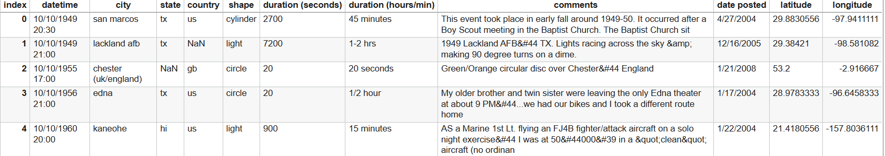
1
Page 04
GROUP
AFTER
BEFORE

Slide 5
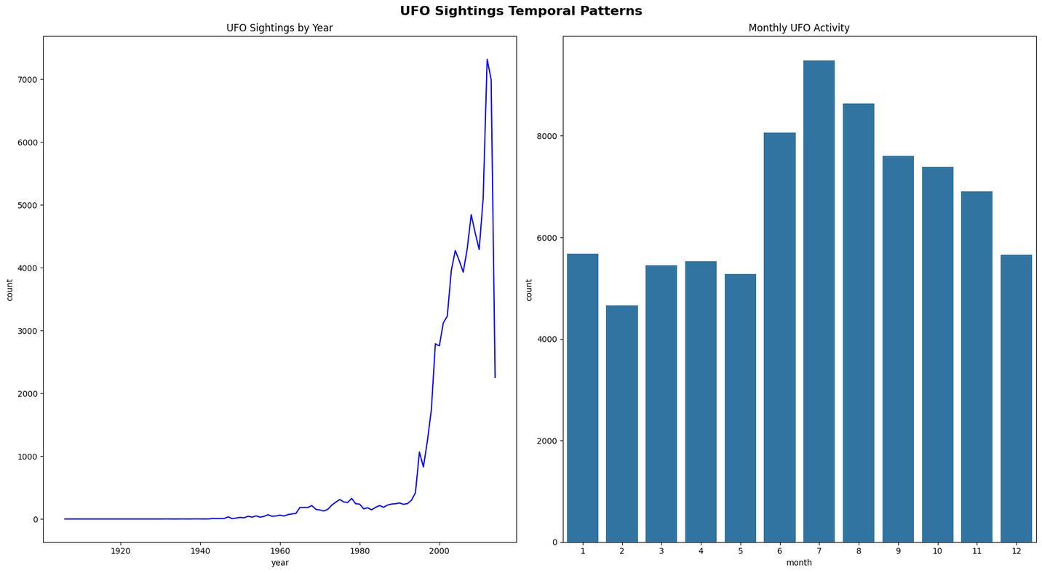
1
Page 05
GROUP
VIZUALIZATSIYA
By grafikimizda hodislar vaqt adavomiyligida ko’payganmi yoki kamaygani
Hamda qaysi oyda oylar ichida qanday kuzatishlar bolganligi haqida.

Slide 6

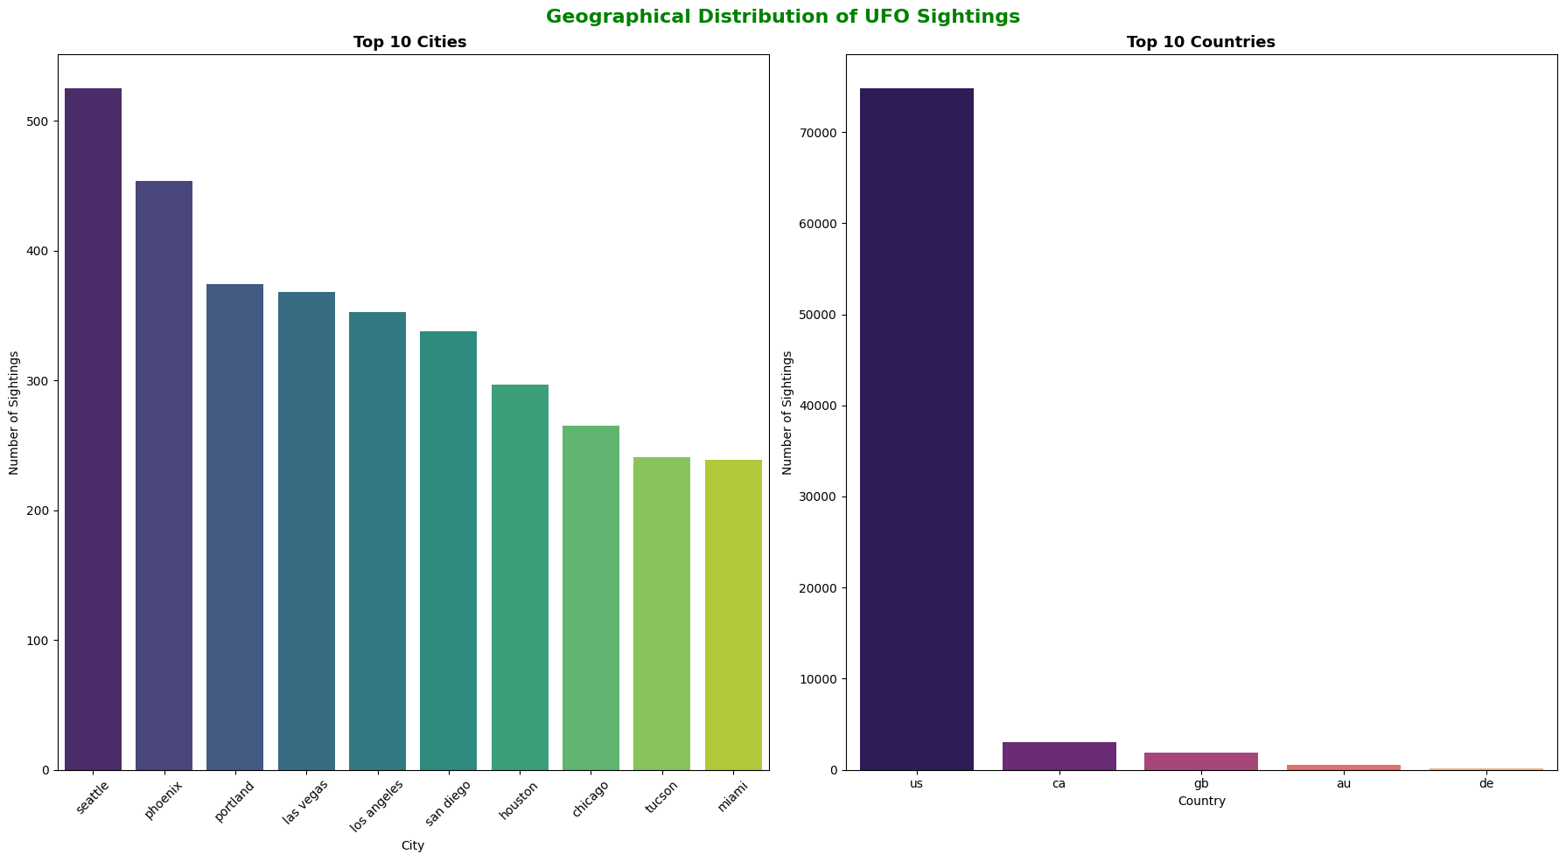
1
Page 06
Group

Slide 7
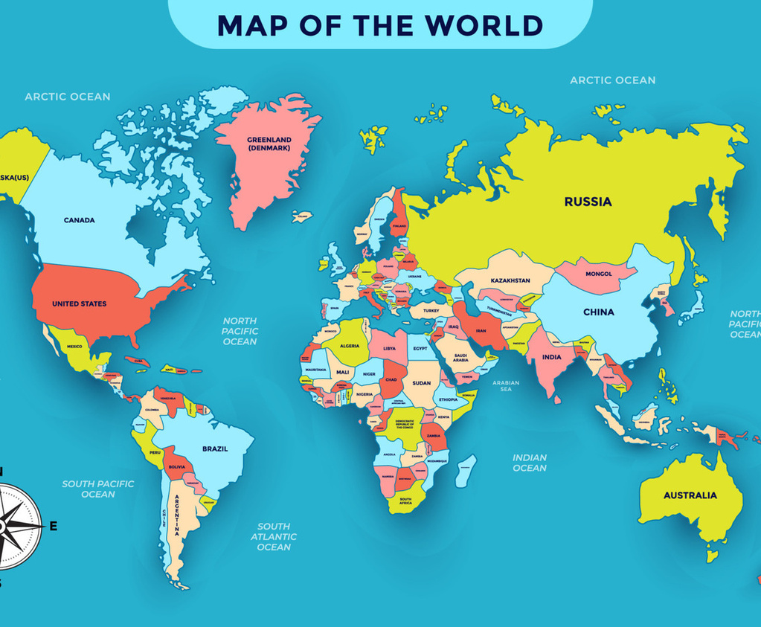
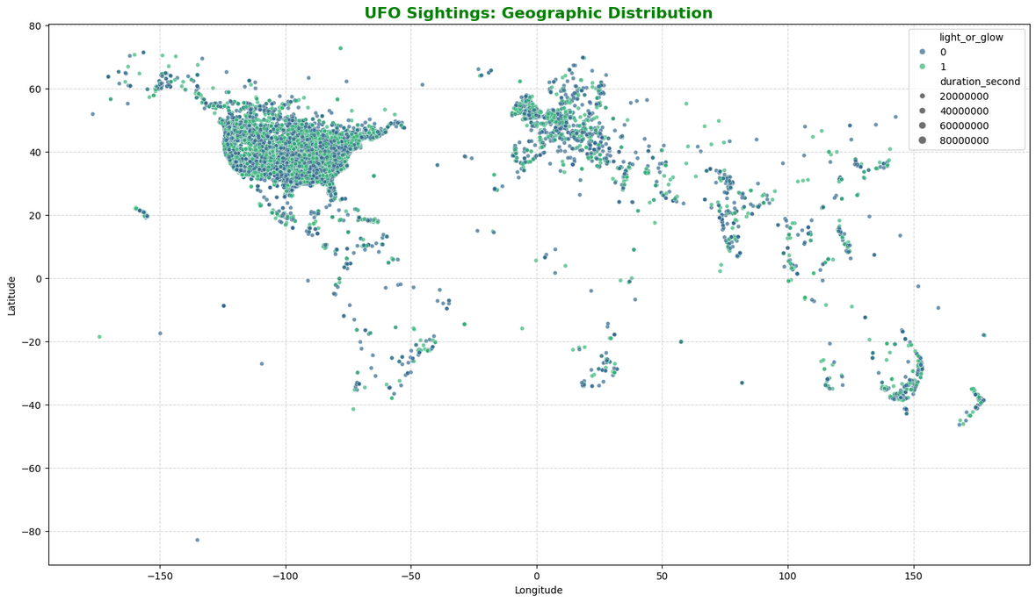

1
Page 07
GROUP

Slide 8
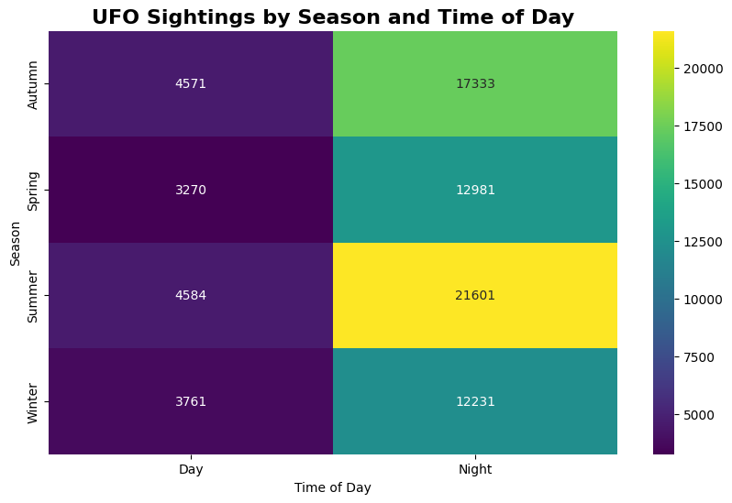
1
Page 08
GROUP

Slide 9
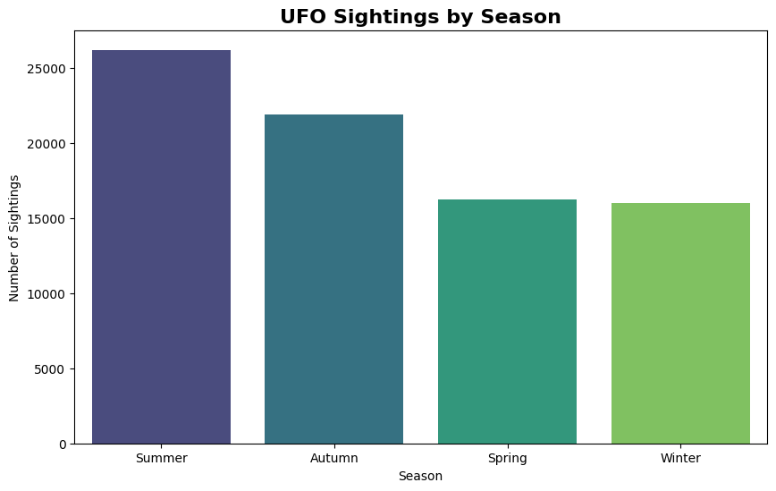
1
Page 09
GROUP

Slide 10
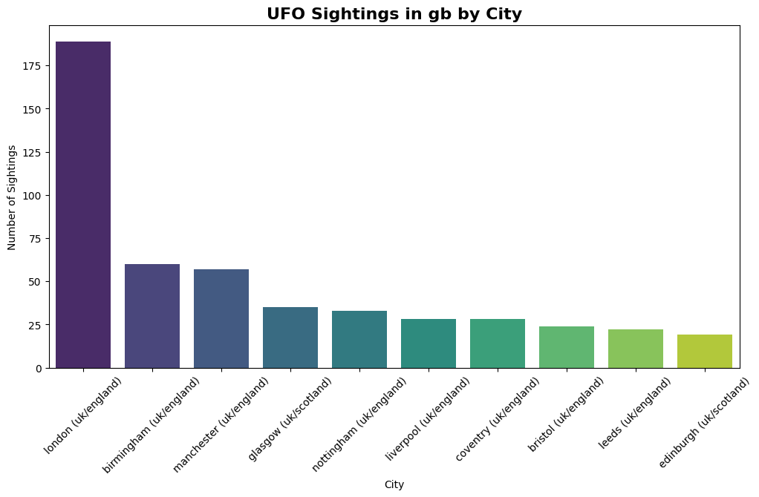
1
Page 10
GROUP

Slide 11
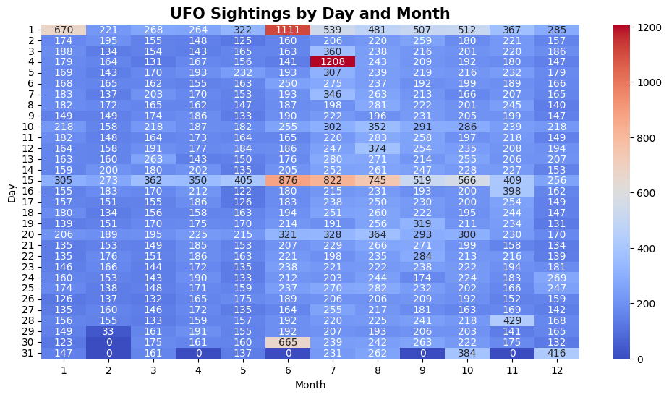
1
Page 11
GROUP

Slide 12

1
Page 11
GROUP
TASHAKKUR
-

